Slide 1
Drought: a climate change PHENOMENON
Waikhom Rahul Singh
Scientist ‘B’
CFMS Guwahati
National Institute of Hydrology

Slide 2
Temperature
Climate change could affect different parts of the world in different ways.
Sea level
Drought
Storms
Flooding

Slide 3
Temperature
The earth is getting hotter.
The past 30 years have been the warmest in the northern hemisphere during the last 1,400 years.
Sea level
Drought
Storms
Flooding

Slide 4
As the water in the oceans warms, it expands and takes up more space.
Ice from the polar caps and from glaciers is melting, adding more water to the seas.
Millions of people living on small, low-lying islands and in low-lying areas will be at risk of flooding.
Salt from rising sea levels could pollute ground water making it undrinkable and more difficult to grow crops.
Temperature
Sea level
Drought
Storms
Flooding

Slide 5
Temperature
Droughts are likely to be more frequent and more intense.
In some areas there will be less water available for drinking and to water crops because there will be less rain.
Sea level
Drought
Storms
Flooding

Slide 6
Temperature
Intense storms, known as hurricanes, cyclones and typhoons, could happen much more often and be more intense as a result of a changing climate.
Sea level
Drought
Storms
Flooding

Slide 7
Temperature
More intense and unpredictable rainfall could produce more flash floods. In coastal areas, there could be more flooding due to more frequent storms and higher sea levels.
Sea level
Drought
Storms
Flooding

Slide 8
Tackling the climate change
Climate Change
Major culprit: CO₂
Environmental Issues
Increasing Temperature
Change in Rainfall Pattern
Change in Season Cycle
Promoting Photosynthesis to consume CO₂
Emerging Approach
Land management
(Agriculture, grassland & forest)
Promoting Photosynthesis
Issues to tackle
Food & Water Insecurity
Deteriorating Soil Health
Depleting Water Resources
Food & Water Security through better Natural Resources Management
The Integrated River Basin Management can be defined as a “process of coordinating conservation, management and development of water, land and related resources across sectors within a given river basin
Integrated River Basin Management

Slide 9
Definitions of Drought
“A protracted period of deficient precipitation resulting in extensive damage to crops, further resulting in loss of yield.” (WMO)
“A situation occurring in any area when the mean annual rainfall is less than 75% of the normal rainfall.” (IMD)
"Drought is caused by not only lack of precipitation and high temperatures but by overuse and overpopulation" (David Miskus, NOAA’s CPC)

Slide 10
Hazard Profile of Drought
Slow-onset, creeping phenomena
Prolonged duration
Widespread
makes assessment and response difficult
RESULT: progress on drought preparedness has been slow

Slide 11
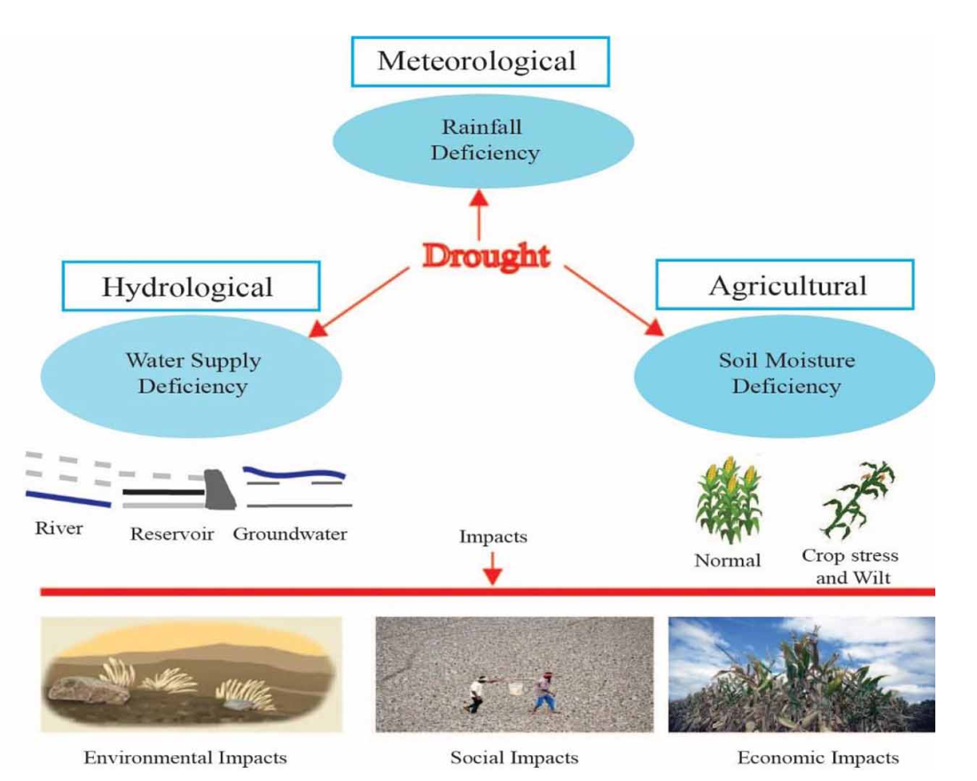
Types of Drought
Drought types can occur separately or simultaneously
Source: Faiz et al. 2021 Drought indices: aggregation is necessary or is it only the researcher’s choice?

Slide 12
Drought Impacts
Economic – Agricultural, Industrial, Tourism, Energy Financial Transportation , Financial, Transportation
Social – Stress & health, Nutrition, Recreation, Public safety, Cultural & aesthetic values
Environmental – Animal, planet, eco systems, wetland water quality, etc.

Slide 13
Impacts of drought
Direct
Loss of lives (human, livestock, wild lives)
Famine
Malnutrition
Loss of income
Social dislocation
Indirect
Loss of revenues
Loss of water access

Slide 14
Droughts in India
1873, 1877, 1899, 1901, 1904, 1905, 1911, 1918, 1920, 1941, 1951, 1965, 1966, 1968, 1972, 1974, 1979, 1982, 1985, 1986, 1987, 2002, 2009, 2014 and 2015
During 1871–2015, there were 25 major drought years:
Drought in India has resulted in tens of millions of deaths over the course of the 18th, 19th, and 20th centuries.
The drought in 1987 was one of the worst, with an overall rainfall deficiency of 19% which affected 59–60% of the normal cropped area and a population of 285 million.
This was repeated in 2002 when the overall rainfall deficiency for the country as a whole was 19%. Over 300 million people spread over 18 States were affected by drought along with around 150 million cattle.
In 2009, the overall rainfall deficiency for the country as a whole was 22%, which resulted in decrease of food grain production by 16 million tonnes.
Source: DAC&FW 2016

Slide 15
Some notable studies regarding droughts in north eastern part of India
In northeast region of India, the probability of drought occurrence was 54%, and it is 27% for Western India during the period 2000–2014.
At Guwahati, during 1951 to 2003 ~~ 6 drought years were observed ~ the worst being the year 1952 when the annual rainfall was only 49% of the average annual rainfall.
In East Sikkim, during 1985-2012, drought was observed for 66.7% and 59.3% of the time in the periods Oct–Dec and Jan–Mar ~~ indicating strong presence of winter droughts.
In North Lakhimpur district of Assam, during 1981 to 1998, the years 1981, 1986 and 1992 were found deficit years with annual rainfall below 81%, 68% and 79% of its mean value respectively. Also, the annual precipitation in the area decreased at 325.6 mm per 100 years.
Parida et al. (2015); B. Jhajharia et al. (2007); C. Kusre and Lalringliana (2014); D. Shrivastava (2008)

Slide 16
Some notable studies regarding droughts in Meghalaya
At Shillong, during 1973 to 2007, 8 years with moderate and 11 years with mild drought ~more frequency of drought incidents in the months of January, November and December.
At Tura, during 1984 to 1997, 9 mild drought occurrences. Again the frequency of drought recorded during month of January, February, November and December was 10, 8, 9 and 11 respectively.
In East Garo Hills district, during 1998 to 2009, 9 mild drought occurrences. Again the frequency of drought recorded during month of January, February, November and December was 8, 6, 7 and 10 respectively.
At Cheerapunjee, during 1971 to 2007, 7 mild drought occurrences.
Source: studies by LIP Ray

Slide 17
Topography: is it a factor for causing drought in hilly regions of northeast India??
Northeast region of India is blessed with high rainfall and enormous number of rivers
Rugged terrain in most parts, it becomes difficult to explore and tap its surface as well as groundwater resources.
Witnessed a discernible shift of climate change and its impacts such as change in pattern of seasonal rainfall, reduced water level in the rivers, loss of springs in various foothills, etc.
When the month March approaches, the discussions of the people in the state capital- Shillong mostly revolve around one word “water” [Sahoo, 2005].

Slide 18
Topography: is it a factor for causing drought in hilly regions of northeast India??
The water situation in the Meghalaya is a case of – “scarcity amidst plenty”
North eastern part of India ~ terrain are mostly mountainous ~ a challenging task in storing and distribution of water.
Higher altitudes ~ higher slopes ~ high runoff potential (low storing capacity) ~ high probability of water scarcity if rainfall especially during monsoon fails.

Slide 20
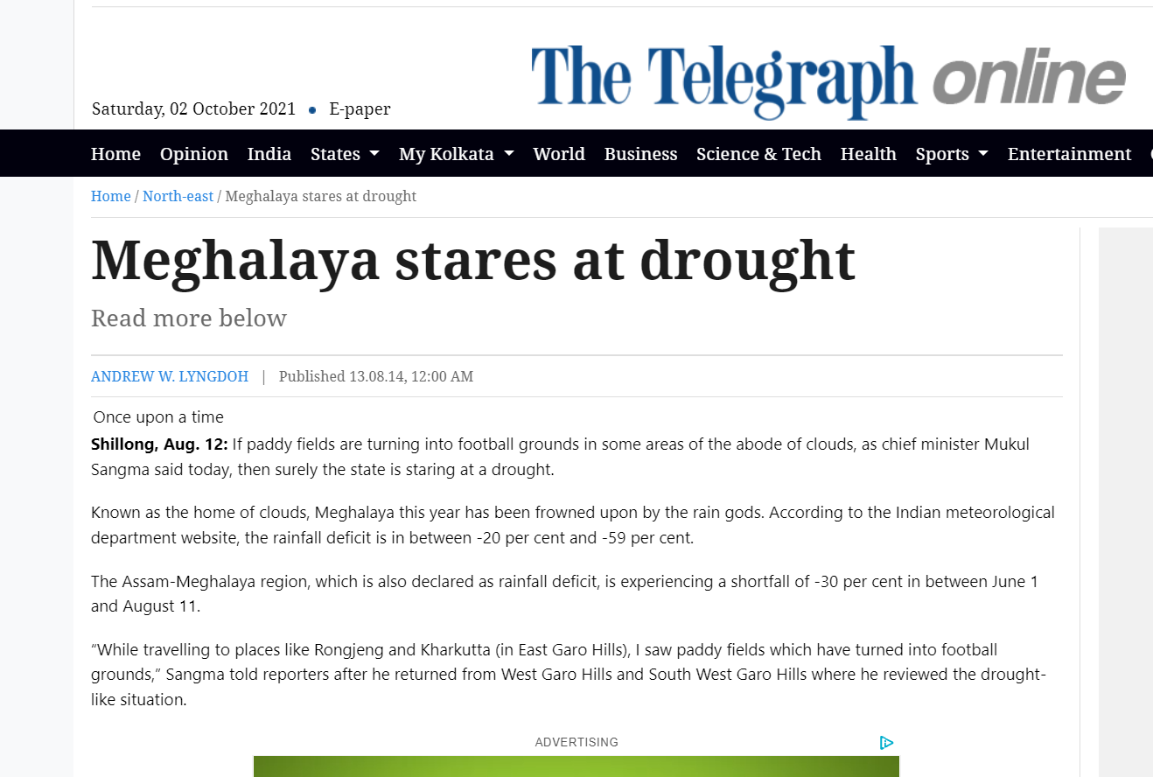

Slide 22
Tackling the DROUGHT
Assessment of Drought
Quantification of drought
Drought Preparedness, Response and Relief
Crisis Management Plan
Contingency plans
Subsidies
Camps
Waivers and concessions
Drought Vulnerability and Risk Assessment
Prevention and Mitigation
Monitoriring of drought
Early warning
Preventive and mitigation measures

Slide 23
Drought Indices commonly known drought indices
Indices | Name | Indices | Name
PDSI | Palmer Drought Severity Index | DI | Decile Index
SMAI | Soil Moisture Anomaly Index | CZI | China-Z Index
RAI | Rainfall Anomaly Index | WASP | Weighted Anomaly Standardized Precipitation Index
SPI | Standardized Precipitation Index | CMI | Crop Moisture Index
SPEI | Standardized Precipitation Evapotranspiration Index | GRI | Groundwater Resource Index
RDI | Reconnaissance Drought Index | SWSI | Surface Water Supply Index
EDI | Effective Drought Index | KBDI | Keetch–Byram Drought Index
SDI | Streamflow Drought Index | NDVI | Normalized Difference Vegetation Index
PNI | Percent Normal Index | ZSI | Z-Score Index

Slide 24
Standardized Precipitation Index
The SPI (McKee et al. 1993) is a powerful, flexible index that is simple to calculate.
The SPI is based on the probability of precipitation for any time scale.
The probability of observed precipitation is then transformed into an index to represent quantitatively
Very effective in analyzing wet periods/cycles as it is in analyzing dry periods/cycles.

Slide 25
Standardized Precipitation Index
Strengths
Precipitation is the only input parameter.
It is flexible: it can be computed for multiple timescales
It is spatially consistent: it allows for comparisons between different locations in different climates
Since, SPI is normalized, it can be used to analyze wet period same as dry periods
Weaknesses
It can only quantify the precipitation deficit;
Values based on preliminary data may change, and values change as the period of record grows.

Slide 26
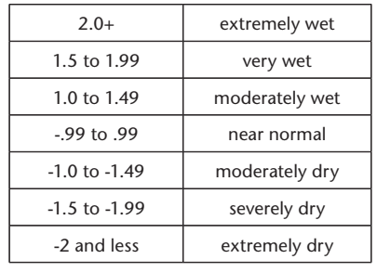
Standardized Precipitation Index
The SPI could also adapt to analyze other types of drought.
Soil moisture conditions respond to precipitation anomalies on a relatively short scale. Groundwater, streamflow and reservoir storage reflect the longer-term precipitation anomalies.
So, for example, one may want to look at a 1- or 2-month SPI for meteorological drought, anywhere from 1-month to 6-month SPI for agricultural drought, and something like 6-month up to 24-month SPI or more for hydrological drought analyses and applications

Slide 27
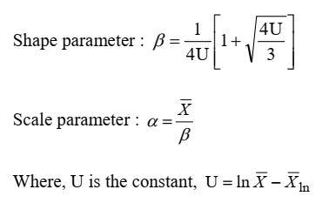
Computation of SPI
Step 1: Determination of monthly rainfall series ‘X’
Step 2: Calculation of the mean for the normalized precipitation values of the log-normal (ln) rainfall series
Step 3: Computation of shape and scale parameter

Slide 28
Computation of SPI
Step 4: Determination of the cumulative probability of an observed precipitation event for the given month and timescale for the station. Gamma probability distribution is commonly used:
Since gamma function is undefined for x = 0 and precipitation distribution may contain zero, the cumulative probability becomes:
Where , q is the probability of zero events in the data series

Slide 29
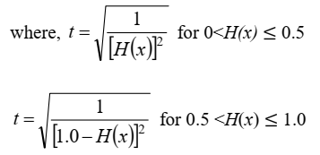
Computation of SPI
Step 5: The cumulative probability, H(x), is then transformed to the standard normal random variable “Z” with mean zero and variance one, which is the value of the SPI

Slide 30
China Z-Index (CZI)
CZI assumes that precipitation data follow the Pearson Type III distribution and is related to Wilson–Hilferty cube-root transformation (Wilson and Hilferty, 1931) from chi-square variable to the Z-scale (Kendall and Stuart, 1977).
The value of CZI is calculated as:
CZI = $\frac{6}{C_{st}}$ ($\frac{C_{st}}{2}Z_{score }$+ 1)^{1/3} - $\frac{6}{C_{st}}$ + $\frac{C_{st}}{6}$
$C_{st}$ = $\frac{\sum_{i=1 }^{n}{({P_{i}− \overline{P})}^{3}}}{n×σ^{3}}$
Z_{Score} = $\frac{P_{i}−\overline{P}}{σ}$
where $σ$= standard deviation; $\overline{P}$ = Mean monthly precipitation and $P_{i}$ = Precipitation in the specific month.

Slide 31
Effective Drought index (EDI)
Effective Drought index (EDI) (Byun, H. R., Wilhite, D. A(1999)) measures the daily water accumulation based on weighted current and antecedent rainfall
EP_{i} = $\sum_{n=1}^{i}{[(\sum_{m=1}^{n}{ P_{m})/n]}}$
Where, EP = Effective precipitation
P_{m} = Precipitation m days ago
i = 1 to 364
The EDI is calculated as follows:
(1) Calculation of the monthly EP.
(2) Calculation of the 30-year mean EP (MEP) for each calendar month.
(3) Determination of DEP, which is the difference between the EP and MEP:
$DEP=EP−MEP$
Finally$, EDI=\frac{DEP}{σ_{DEP}}$
Where, $σ_{DEP}$ = standard deviation of each month-DEP.

Slide 32
Standardized Precipitation Evaporation Index (SPEI)
SPEI uses the differences between precipitation (P) and potential evapotranspiration (PET) as input data instead of precipitation only.
Thornwaite’s method
a) $PET=16×{\left(\frac{{10T}_{i}}{I}\right)}^{∝}\left(\frac{N}{30}\right)\left(\frac{L}{12}\right)$
b) $I=\sum_{i=1}^{12}{{\left(\frac{T_{i}}{5}\right)}^{1.514}}$
c) $∝=\left(6.75×{10}^{−7}\right)I^{3}−\left(7.71×{10}^{−5}\right)I^{2}+\left(1.792×{10}^{−2}\right)I+0.49239$
where $T_{i}=$mean monthly temperature (°C), and N = mean monthly sunshine hour, L = average day length of that month in hours, I = heat index equal to the sum of 12 monthly index values of I and $α$ is an empirically derived exponent that is a function of I.

Slide 33
Weighted Anomaly Standardized Precipitation Index (WASP)
It is based on overlapping N-month sums of weighted, standardized monthly precipitation anomalies, S_{N}
${ S}_{N}=\sum_{i=1}^{N}{\left(\frac{P_{i}−\overline{P_{i}}}{σ_{i}}\right).\frac{\overline{P_{i}}}{\overline{P_{A}}}}$
P_{i} and $\overline{P_{i}}$are the observed and mean values of precipitation, for the i^{th} month; N is the total no. of months (N=12); $σ_{i}$ is the standard deviation of the i^{th} month ; P_{A} = mean precipitation of the year.
The weighting factor, P_{i}/P_{A} is used to dampen large standardized anomalies
${WASP}_{12}=\frac{S_{12}}{σ_{S_{12}}}$
where $σ_{S_{12}}=$standard deviation of the S₁₂ series.

Slide 34
Reconnaissance Drought Index (RDI)
This method is based on the ratio between two aggregated quantities of precipitation and potential evapotranspiration.
The role of ET₀ in the detection of drought events has been helpful in the development of a new reconnaissance drought identification and assessment index.
$α_{0}$ is calculated as the coefficient of the $i^{th}$ year in aggregated form, using a monthly time step as follows:
${α_{0}}^{\left(i\right)}= \frac{\sum_{j=1}^{12}{P_{ij}}}{\sum_{j=1}^{12}{{PET}_{ij}}}$
where, i = 1 to N, j = 1 to 12 (January to December), $P_{ij}$ and ${PET}_{ij}$ are precipitation and potential evapotranspiration of the j^{th} month of the i^{th} month and N is the total number of months in the existing data.

Slide 35
The Normalized RDI (RDIn) is computed using $\overline{α_{0}}$ as the arithmetic mean of α₀ values.
${{RDI}_{n}}^{\left(i\right)}= \frac{{α_{0}}^{(i)}}{\overline{α_{0}}}−1$
Then, standardized RDI is computed using equation:
${ RDI}_{(st(k)}^{(i)}= \frac{{y_{k}}^{(i)}− {\overline{y}}_{k}}{{\hat{σ}}_{y_{k}}}$
where, $y_{i}$ is the $\ln{({α_{0}}^{(i)})}$, ${\overline{y}}_{k}$ is the arithmetic mean and ${\hat{σ}}_{y_{k}}$is the standardized deviation.
The standardized RDI behaves similar to the SPI and so is the interpretation of results. Therefore, the RDI_{st} can be compared to the same thresholds as the SPI.

Slide 36
Rainfall Anomaly Index (RAI)
It was developed by Van Rooy (1965). The positive and negative RAI indices are computed by using the mean of ten precipitation extremes. The positive and negative RAI are given in equations:
$RAI=3\frac{P−\overline{P}}{\overline{M}−\overline{P}}$
$RAI=−3\frac{P−\overline{P}}{\overline{m}−\overline{P}}$
where, $P$ is the precipitation of the specific month; $\overline{P}$ is the mean precipitation of all the years under consideration; $\overline{M}$ is the mean of the ten highest precipitation for the concerned period and $\overline{m}$ is the mean of the ten lowest precipitation for the concerned period.

Slide 37
Percent of Normal Index (PNI)
The PNI for characterizing meteorological drought severity is defined by dividing the actual precipitation (P_{i}) by the normal precipitation ($\overline{P}$), which is typically considered to be a mean of 30 years, and multiplying by 100%. It is expressed by the following equation:
$PNI=\frac{P_{i}}{\overline{P}} ×100$

Slide 38
De Martonne Aridity Index (I_{DM})
This is an aridity–humidity index and is only applicable locally.
A measure of aridity of a region, proposed by De Martonne (1925), is given by the following relationship:
$I_{DM}=\frac{P}{T+10}$
where, P is the monthly precipitation, mm; T is monthly mean air temperature, ºC.
The De Martonne aridity index decreases (approaches zero) with increasing aridity.

Slide 39
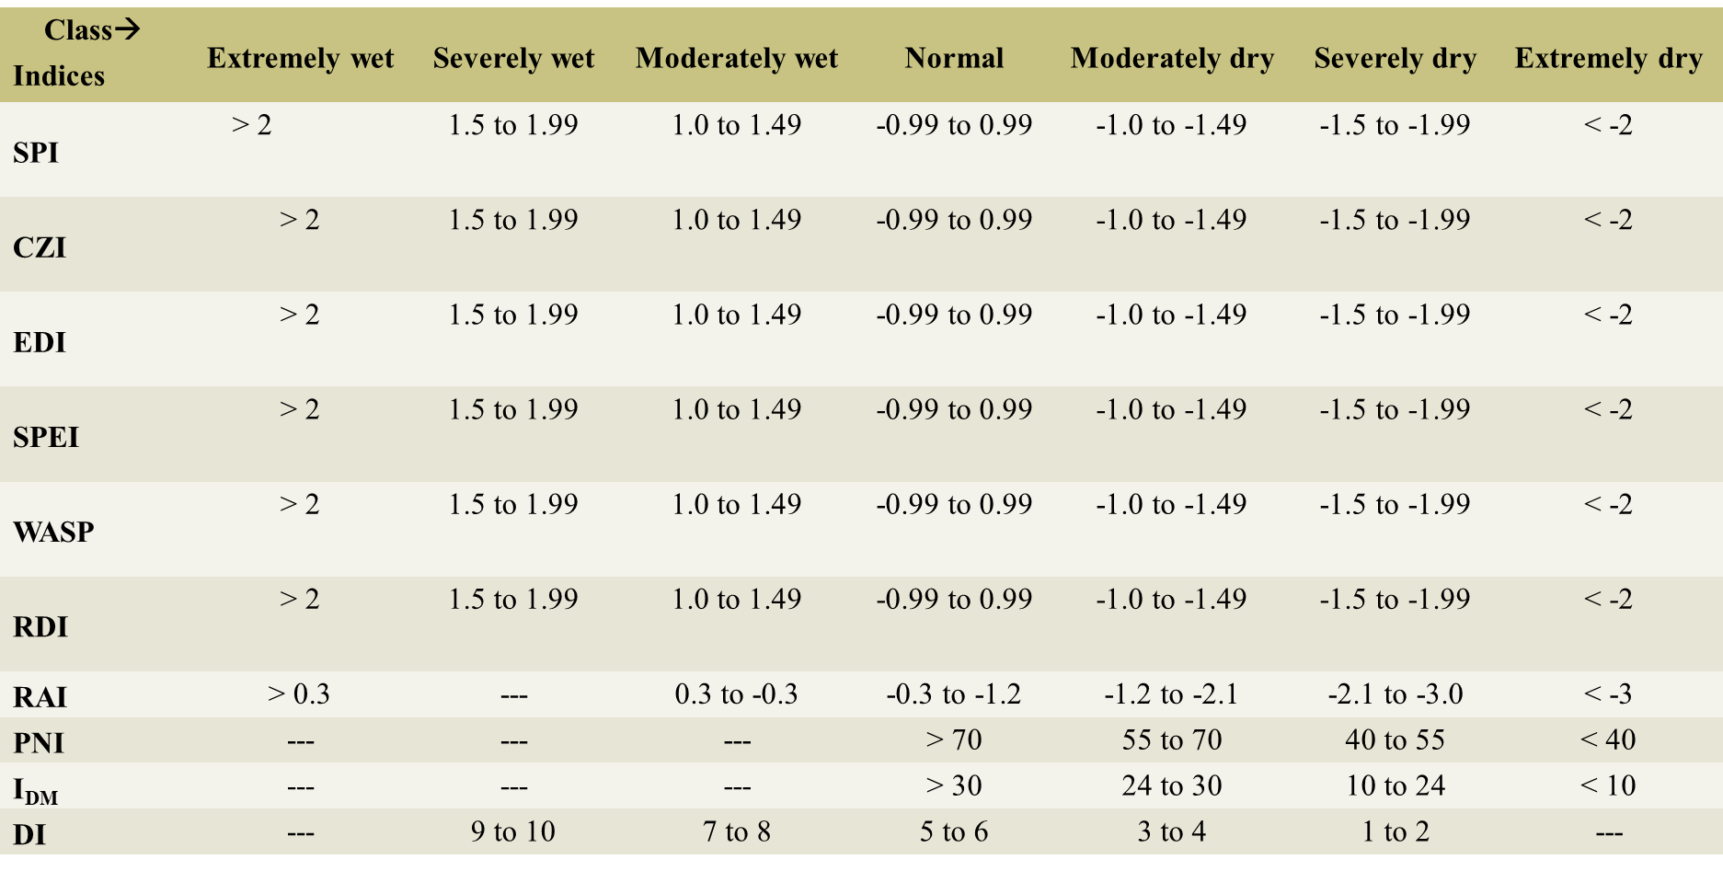
Deciles (DI)
Scales with value ranging from 1 to 10
Low values on this scale represent conditions that are drier and high values represent conditions that are wetter than normal

Slide 40
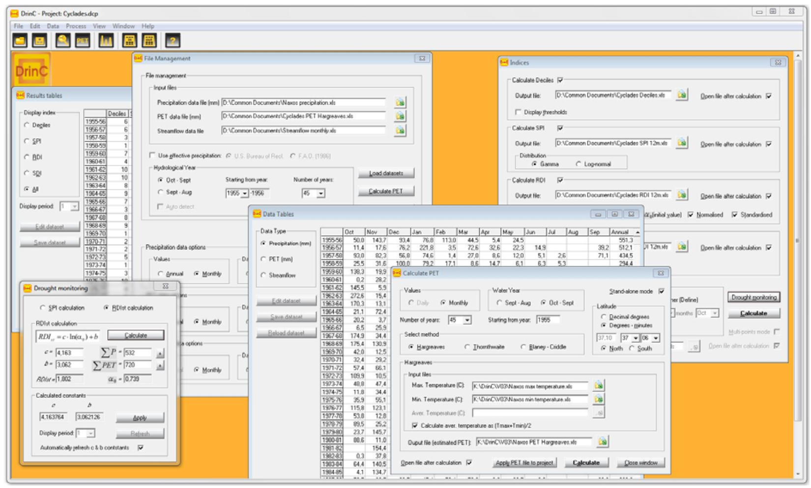
COMMON SOFTWAREs to CALCULATE DROUGHT INDICES
DrinC (Drought indices Calculator) Software
SPI: Standardized Precipitation Index
RDI: Reconnaissance Drought Index
DI: Decile Index
SDI: Streamflow Drought Index
Developed by Tigkas et al. 2015

Slide 41
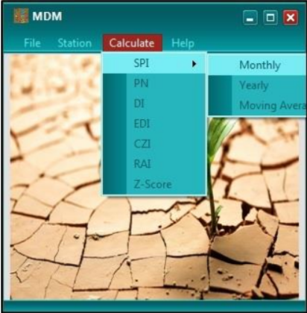
COMMON SOFTWAREs to CALCULATE DROUGHT INDICES
MDM (Meteorological Drought Monitoring) Software
SPI: Standardized Precipitation Index
PN: Percent Normal
DI: Decile Index
EDI: Effective Drought Index
CZI: China-Z Index
RAI: Rainfall Anomaly Index
Z-Score: Z-Score Index
RDIT (Rain-based Drought Indices Tool) Software
Advanced version of MDM with additional drought indices like:
MCZI: Modified China-Z Index
DDI: Degree of Dryness Index
Developed by Salehnia et al. 2017

Slide 42
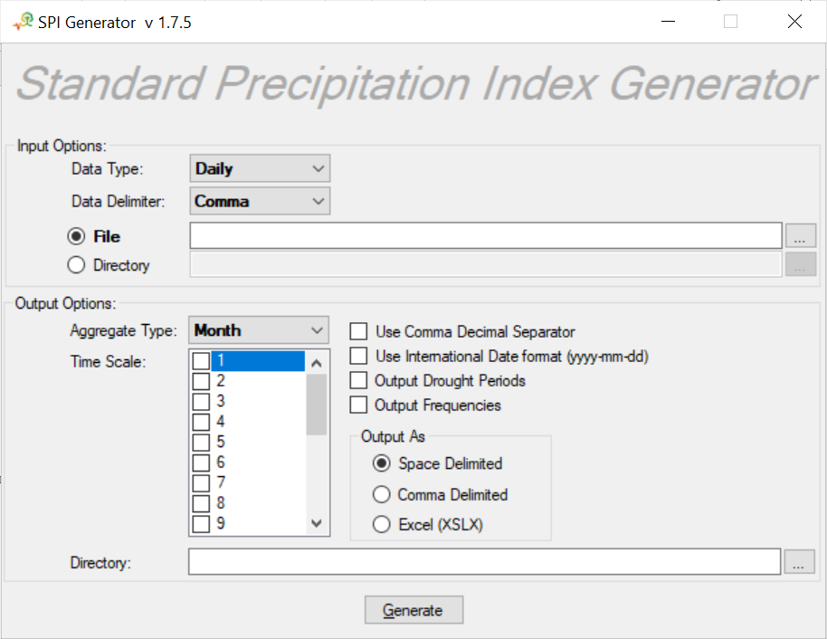
COMMON SOFTWAREs to CALCULATE DROUGHT INDICES
SPI_SL_6
Developed by NDMC 2014
For windows OS
Written in C++ language
Can calculate 6 timescales of SPI at once
Monthly precipitation required
No longer available
SPI Generator
Developed by NDMC 2018
For Windows as well as UNIX command
Can calculate 20 timescales of SPI at once
Precipitation input can be daily, weekly and monthly
SPI outputs are in either weekly or monthly time aggregation

Slide 43
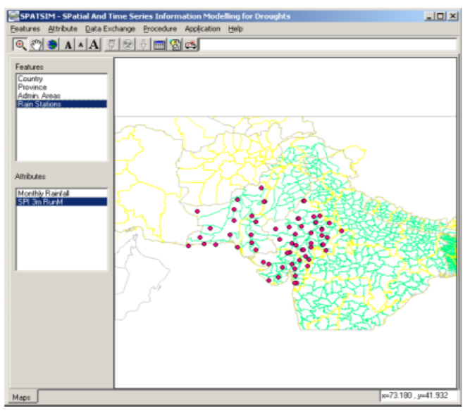
COMMON SOFTWAREs to CALCULATE DROUGHT INDICES
SPATSIM (SPAtial and Time Series Information Modelling) software package
Developed by Institute for Water Research of Rhodes University in South Africa
For windows OS
GIS shapefiles as the main form of data access
SPI
DI
EDI
Departures from long term mean and median precipitation

Slide 44
COMMON SOFTWAREs to CALCULATE DROUGHT INDICES
SPEI package
Developed by Begueria and Vicento-Serrano 2013
Works in R-environment
SPI
SPEI
CDI (Combined drought Index)
Developed by FAO SWALIM (Balint et al. 2011)
Combination of various indicators such as:
PDI: Precipitation drought index
TDI: Temperature Drought Index
VDI: Vegetation Drought Index

Slide 45
Daily EDI time series from 1981 to 2013

Slide 46
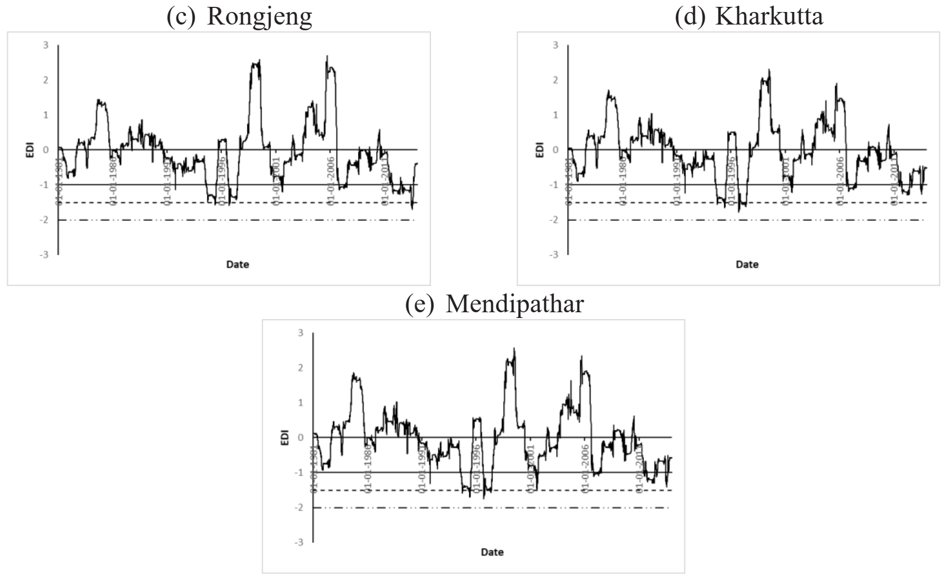
Daily EDI time series from 1981 to 2013

Slide 47
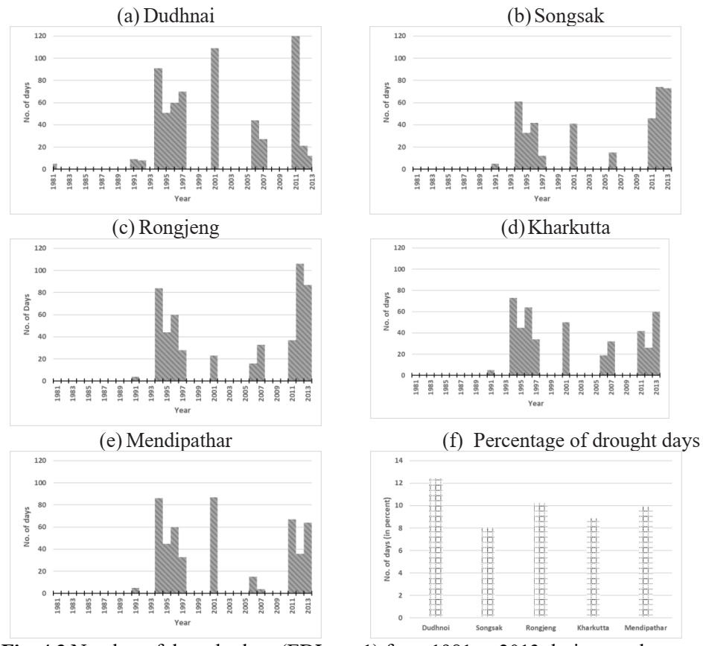
No. of drought days during southwest monsoon

Slide 48
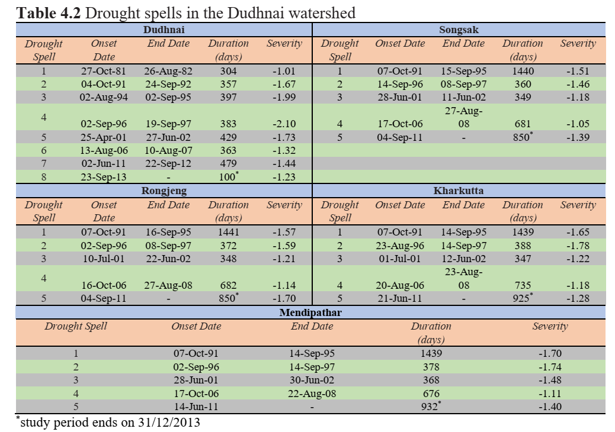

Slide 49
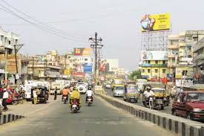
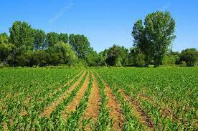
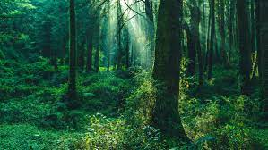
Drought & land use Relation
DESERT
POPULATED CITY
CULTIVATED LAND
FOREST

Slide 50
Vulnerability Assessment of drought
Climatic indicators of drought
VULNERABILITY ASSESSMENT
Socio-economic indicators of drought

Slide 51
Climatic indicators of drought
Annual Rainfall
More is the rainfall → less the vulnerability
Trend of rainfall
+ve trend → wet weather intensification
-ve trend → dry condition intensification
Trend of temperature
Rising trend → dry condition intensification & vice versa

Slide 52
Climatic indicators of drought
Drought frequency
Greater frequency of drought → greater vulnerability
Different timescale may be used (3-, 12-, 24- months)
Drought return period
Greater return period of drought → lesser vulnerability
Different timescale may be used (3-, 12-, 24- months)

Slide 53
Climatic indicators of drought
Critical rainfall
More the rainfall needed will raised drought chances
Wet day frequency
Decreasing wet day frequency → dry condition intensification
Evaporation
Higher evaporation → dry condition intensification

Slide 54
Socio-economic indicators of drought
Cropping Intensity
More cropping intensity → more vulnerability
Percentage of small and marginal farmers
More small and marginal farmers → more vulnerability
Irrigation Intensity
Higher irrigation intensity → higher vulnerability

Slide 55
Socio-economic indicators of drought
Surface water and Groundwater availability
More water availability → less vulnerability
Gross irrigated area
More irrigated area → more vulnerability
Population density
More population density → higher vulnerability

Slide 56
Socio-economic indicators of drought
Health, Income and Education
Good health, more income & more education → less vulnerability
Land uses
Areas closer to water bodies and forest are less vulnerable than cultivated and populous cities
Soil type
Soils with higher loam contents are less vulnerable than sandy soils

Slide 57
Drought vulnerability Index
Weights have to be assigned to each climatic and socio-economic factors
Simple weighting methods
Fuzzy AHP method
DVI = (Factors x Weights)/N
Finally classification of the DVI and generation of Vulnerability maps

